Slide 1















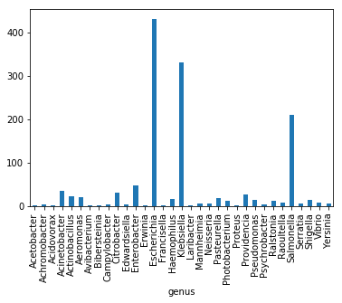
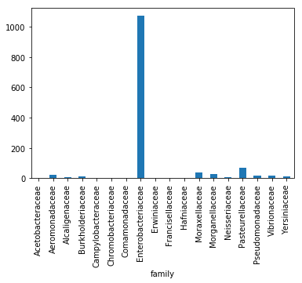





High Throughput Identification of Antibiotic resistance Genes in Plasmids
Mentors: David Beck & Mitch Pesesky | Rayna Tilley | Chemical Engineering (Beck Research Lab)
UW Benjamin Hall Interdisciplinary Research Building, 616 NE Northlake Pl, Seattle, WA 98105, United States
Background
Research and Implementation
Conclusion
Antibiotic resistance is an increasing global threat, in many cases caused by specific antibiotic resistance genes. For some pathogens, these antibiotic resistance genes are usually present on plasmids- DNA elements, separate from the chromosome, that can be exchanged between bacteria. We are studying how plasmids can exchange specific genes with each other (becoming mosaic plasmids), potentially collecting several antibiotic resistance genes on a single plasmid.
Developed a high throughput screen for antibiotic resistance genes in a plasmid database using hidden Markov models.
Hidden Markov models are effective for detecting antibiotic resistance genes.
The Enterobacteriaceae family is enriched in the set of antibiotic resistance genes and plasmids possibly because they are human pathogens and they are under a lot of antibiotic pressure.
Resfams¹
HMM models
1
Plasmid
NCBI
Database
HMM Scan (HMMER⁴)
The hmm scan will scan all of the plasmids using hidden Markov models.
1
Download plasmid data and the Resfams data with hidden Markov models¹. These are statistical models are of the order and separation of amino acids in families of proteins.
HMM Scan Data File
2
Tools
Python Based Pipeline
(See Open Source Software)
NCBI Taxonomy
Python, Biopython², GitHub, Jupyter Notebooks³, Anaconda, Pandas, HMMER⁴, NumPy, Matplotlib
Goals
Open Source Software
Figures
2
Create software to identify antibiotic resistance genes present in plasmid sequences using the Resfams antibiotic resistance gene hidden Markov model profiles.
Validate the use of hidden Markov model profiles to detect antibiotic resistance genes in plasmids.
Compare antibiotic resistance gene occurrence at different levels of taxonomy.
Antibiotic Resistance Gene Identifications and Taxonomy
The core of the computational pipeline is this Python component. It reads in the HMM Scan Data File and the NCBI taxonomy data. Then assigns the antibiotic resistance genes to the appropriate taxonomy and makes figures.
This QR scan will take you to the plasmid_search repository in GitHub. You will be able to look at the Plasmid.ipynb file from Jupyter Notebook containing the code that produced these results..
References
Figure 1
Results
Figure 2
Gibson et al. ISME Journal. 2014, doi:ISMEJ.2014.106.
Cock et al. Bioinformatics. 2009, 25, 1422-1423.
Kluyver et al. IOS Press. 2016, 10.3233/978-1-61499.
Eddy. PLoS Comp. Biol. 2011, 7:e1002195.
Antibiotic resistance gene occurrence at different taxonomy levels are shown in Figures 1 & 2 for family and genus, respectively. In Figure 1, the Enterobacteriaceae family has a greater amount of antibiotic resistance genes than the other families. In Figure 2, Escherichia, Enterobacter, Klebsiella, Shigella, Yersinia, and Salmonella are all genera in the Enterobacteriaceae family, thus because they are so abundant it makes the outlier of the Enterobacteriaceae family more plausible.
Beck Research Lab Info
Acknowledgments
“The Beck Research Lab works on varied applications of computational biology and chemistry including biogeochemical cycling, human health, and the natural and built environments.”
~Beck Research Lab
I would like to thank my professor Dr. David Beck for being my mentor for the summer and for his guidance, and Dr. Mitch Pesesky for allowing me to participate and learn from his project. Thank you Women in Science and Engineering (WiSE) for giving me this wonderful opportunity.

